Slide 1


HELLO EVERYONE
Welcome to my
CURRICULAM VITAE

Slide 2
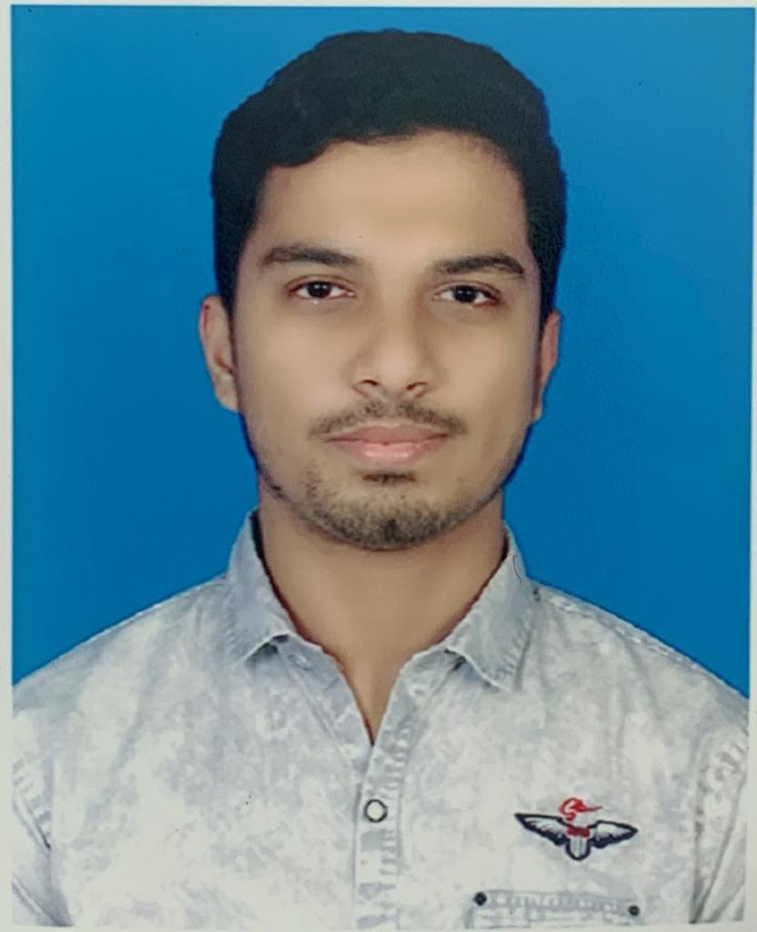
01
SHAID IBNA SOBHAN
FACULTY OF COMPUTER SCIENCE & ENGINEERING
PATUAKHALI SCIENCE & TECHNOLOGY UNIVERSITY

Slide 3
PERSONAL SUMMARY
BIRTH DATE: 14 oct 2001
BIRTH PLACE: Feni
FATHER: Bazlus Sobhan
MOTHER: Farida Yeasmin
NATIONALITY: Bangladeshi
RELIGION: Islam

Slide 4
Bsc. in Computer Engineering
University: Patuakhali Science & Technologly University
Starting year: 2023
Higher Secondary School Certificate
Institute: Motijheel Govt. boys school & college
Passing year: 2020
GPA: 5.00
EDUCATION
Secondary School Certificate
Institute: National Bank Public School & College
Passing year: 2018
GPA: 5.00

Slide 5
PRESENT ADDRESS
Rainbow pearl, House no.: 654, Flat: B5,
Jaha Box Lane, Boro Moghbazar, Dhaka-1217
PARMANENT ADDRESS
Ullal Miar Bari, Post office: Dudmukha,
Thana: Dagonbuiyan, District: Feni

Slide 6


ADVANCE SKILLS
LANGUAGE SKILLS
OTHERS SKILLS
C programming in C & C++
MS word
MS powerpoint
MS Excel
Learning JAVA
Bangla
English
Hindi
Arabic
Leadership
Content Writting
Advance Video Editing
Athletics

Slide 7
CALL
01825809073
E-MAIL
CONTACT
shaidmeheraj9@gmail.com
LOCATION
654, Moghbazar,Dhaka

Slide 8
THANK YOU

